Slide 1
Experimental Results
All_IVCs Algorithm

Slide 2
Overhead of different algorithms
Algorithm | min | max | avg | stdev
All_IVCs | 16.741% | 9467.2% | 1000.889% | 1254.364%
minimization | 0.0% | 40.431% | 1.540% | 5.126%
IVC_UC | 0.0% | 200.0% | 20.577% | 31.237%
IVC_UCBF | 15.637% | 7594.871% | 844.327% | 1014.370%

Slide 3
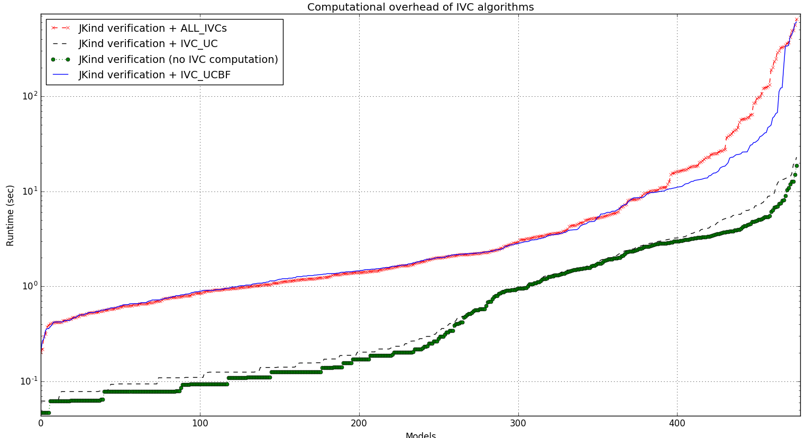

Slide 4
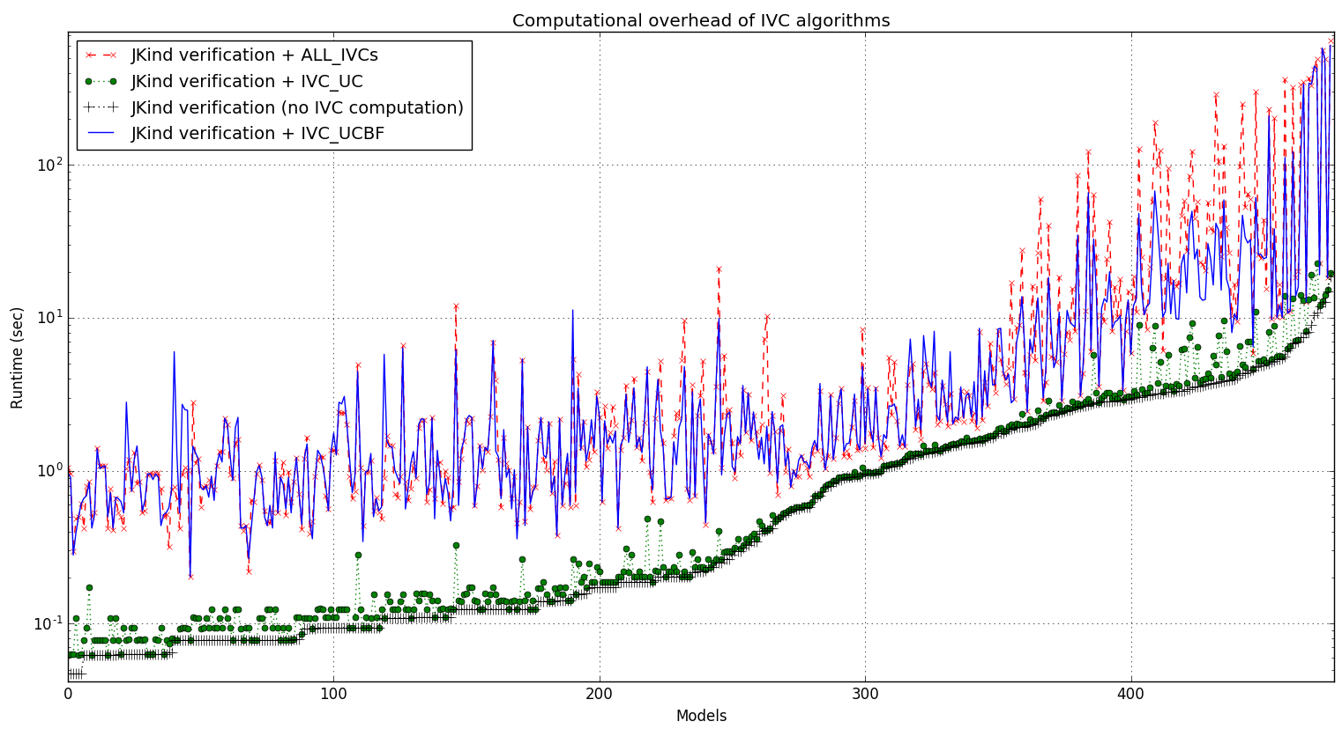

Slide 5
Running time of different algorithms
Running time (sec) | min | max | avg | stdev
All_IVCs + proof time | 0.203 | 650.164 | 20.720 | 72.105
minimization + All_IVCs + proof | 0.203 | 650.164 | 21.173 | 73.419
IVC_UC + proof time | 0.062 | 22.86 | 1.690 | 3.017
IVC_UCBF + proof time | 0.203 | 604.455 | 14.049 | 60.123
Proof time | 0.047 | 18.648 | 1.341 | 2.186
All_IVCs | 0.125 | 631.516 | 19.379 | 70.5189
IVC_UC | 0.0 | 11.97 | 0.349 | 1.242
minimization | 0.0 | 20.212 | 0.453 | 2.182

Slide 6
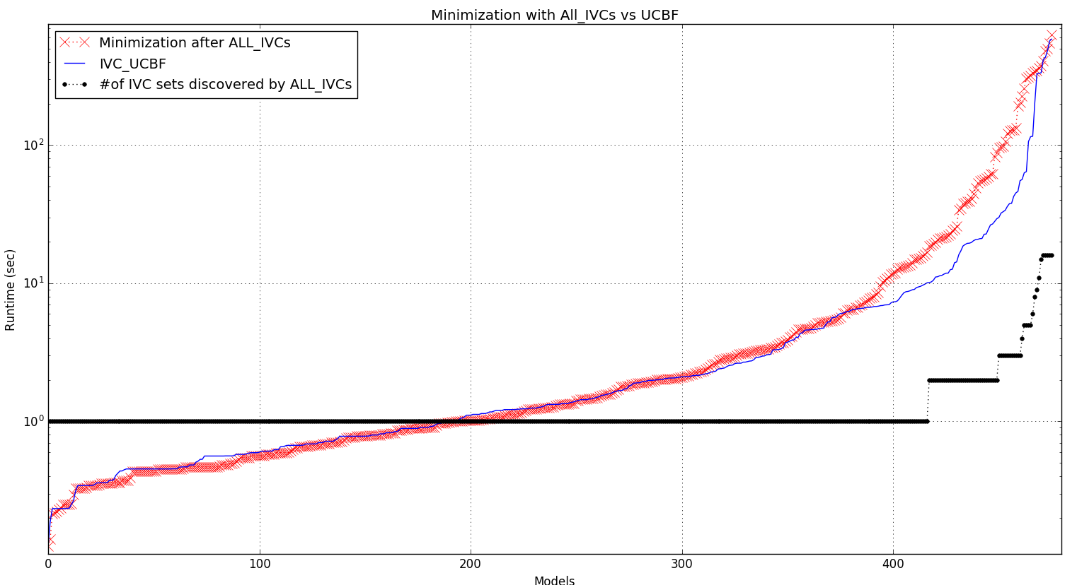

Slide 7
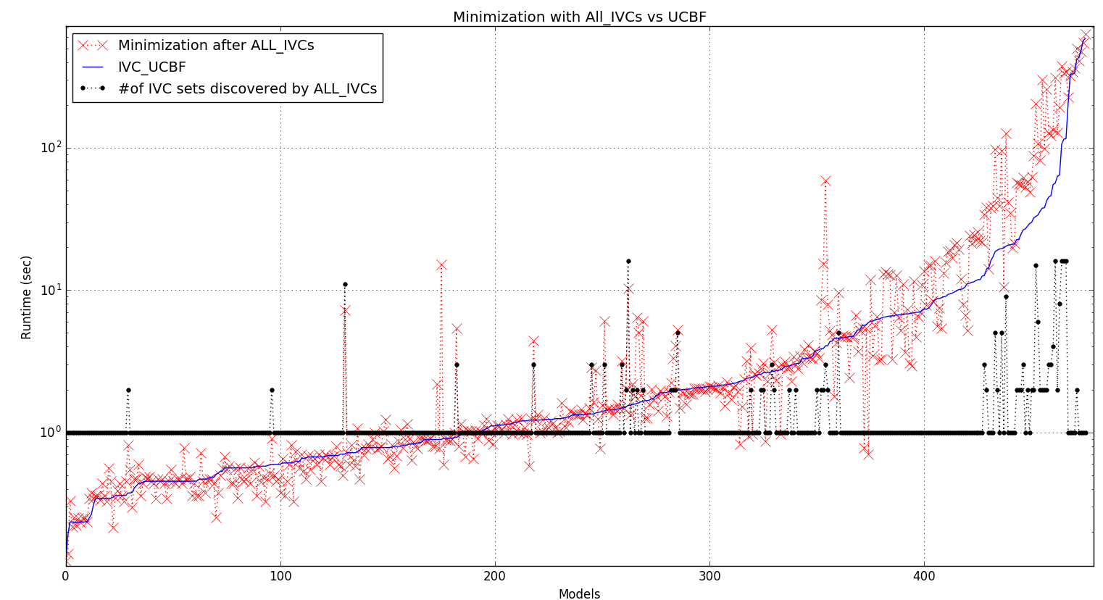

Slide 8
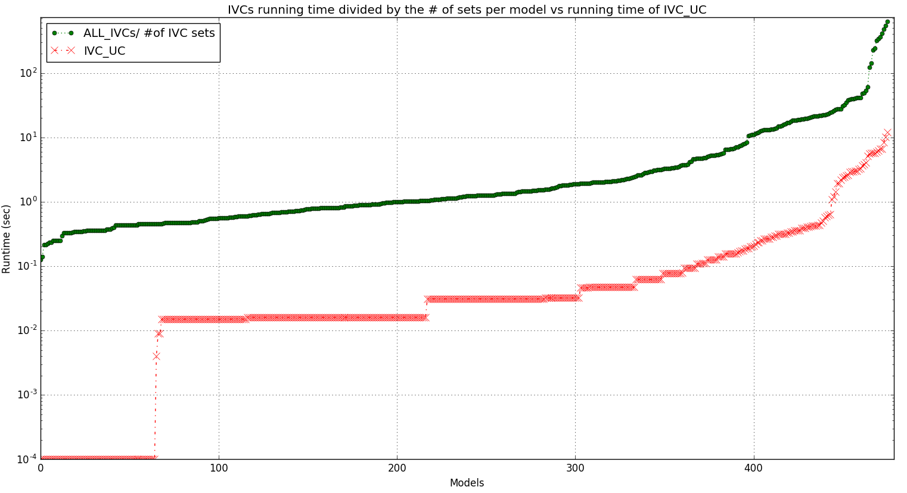

Slide 9
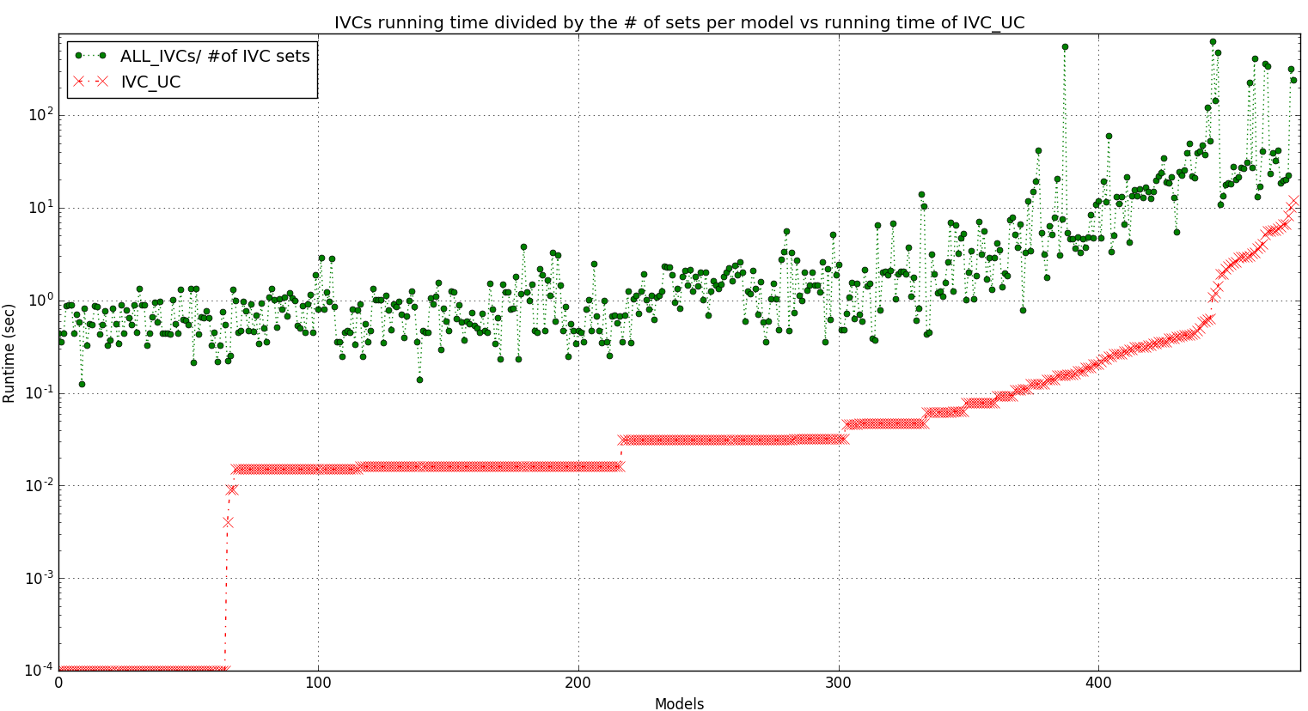

Slide 10
Info on IVC_UCBF minimization runs
Running time (sec) | avg | stdev
All runs among all models | 0.58 | 4.42
VALID runs among all models | 2.81 | 1.12
INVALID runs among all models | 0.16 | 0.29
UNKNOWN runs among all models | 5.54 | 0.12

Slide 11
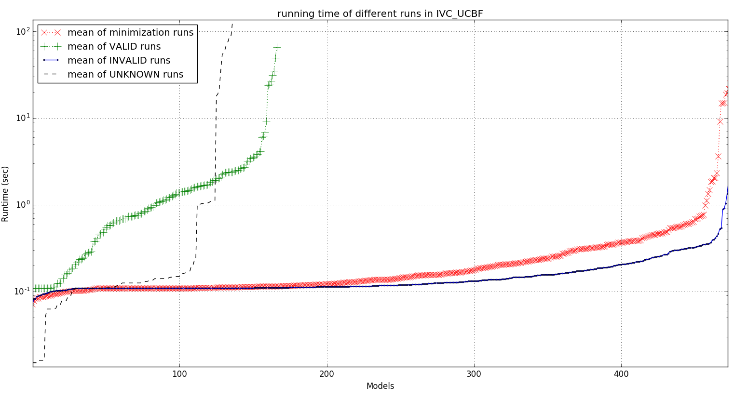

Slide 12
